Slide 1
Applied Mechanics Computer(I/II)

Slide 2
Chapter 1.Introduction

Slide 3
1.1.Defination and Scope of Applied Mechanics

Slide 4
Mechanics
The branch of science which describe and predicts the condition of rest or motion of bodies under the action of the forces.
Engineering mechanics applies the principle of mechanics to design, taking into account the effects of forces.

Slide 5
Classification of Mechanics
1.Engineering Mechanics(Newtonian Mechanics)
2.Relativistic Mechanics
3.Quantum Mechanics

Slide 6
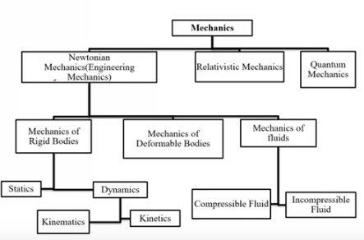

Slide 7
Applied Mechanics
Applied mechanics also known as engineering mechanics.
is the branch of engineering which deals with the laws of mechanics as applied to the solution of engineering problems.

Slide 8
Branch of applied mechanics
Applied Mechanics
Static
Dynamic
Kinetic
Kinematic

Slide 9
1. Statics:
The branch of applied mechanics which deals with the forces and their effects while acting upon bodies which are at rest is called statics.
Any body at rest and forces and effects acting on it.

Slide 10
2.Dynamics:
The branch of applied mechanics which deals with the forces and their effects while acting upon bodies which are in motion is called dynamics.
Any bodies moving and force and effects acting on it.

Slide 11
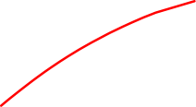


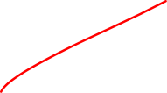
Dynamics:
It is further divided into two types:
A. Kinetic B. Kinematic

Slide 12
Kinetics: The branch of dynamics which deals with the relationship between motion of bodies and forces causing motion is called kinetics.
Study of forces acting on an object
Newton’s second law of motion is widely used.
Example: Force applied to the cricket ball

Slide 13
Kinematics: The branch of dynamics which deals with motion of bodies without considering the forces which cause motion is called kinematics.
Specially concern with the motion of the object without reference to the forces which causes the motion.
E.g Velocity and acceleration of the ball.

Slide 14
S.No | Kinetic | Kinematic
1. | Deals with the causes for the motions of the object. | Deals with the position, acceleration, velocity, speed of an object.
2. | Mass of an object is taken into consideration. | Mass of an object is not taken into consideration.
3. | Use kinetics in designing of different machine etc. | Use kinematics in the study between the components.
4.
5.

Slide 15
Physical Quantity
Any quantity which can be measured is called physical quantity.
Physical Quantity
Two Types
Fundamental or Basic quantities
Derived quantities

Slide 16
1. Fundamental or basic quantities:
The mutually independent quantities are called fundamental or basic quantities.
2. Derived Quantities:
The quantities which can be expressed in terms of fundamental or basic quantities are called derived quantities e.g.
Velocity = Displacement/ Time = Length/Time
Linear momentum = Mass x velocity
= Mass x Length/ Time

Slide 17
SYSTEMS OF UNITS
Four systems of Units
C.G.S. Systems
F.P.S. Systems
M.K.S Systems
S.I. Systems

Slide 18
1. C.G.S. Systems: In this system, the units of length, mass and time are centimetre, gram and second respectively.
2. F.P.S. Systems: In this system, the units of length, mass and time are foot, pound and second respectively.
3. M.K.S. Systems: In this system, the units of length, mass and time are metre, kilogram and second respectively.
4. S.I. Systems: In this systems, the units of length, mass and time are metre(m), kilogram(kg) and second(s) respectively.

Slide 19
1.2 Concept of rigid and deformed bodies

Slide 20
Rigid Body
A rigid body may be defined as a body which does not changes in shape and size under the effect of forces acting on it.
In fact , no body is perfectly rigid.
Every body when acted upon by external forces will undergo certain changes.

Slide 21
Deformed bodies
In mechanics, any body that changes its shape and/or volume while being acted upon by any kind of external force.
A body that have small amount of deformation when a load is applied to it and due to this deformation resistance developed in it which is equal to the external force acting on it is called deformable bodies.

Slide 22
1.3 Fundamental concept and principles of mechanics
The study of mechanics rest on six fundamentals principles based on experimental evidence
The parallelogram law of forces
The principle of transmissibility of force
Newton’s first law of motion
Newton’s second law of motion
Newton’s third law of motion
Newton’s law of gravitation

Slide 23
Principle of transmissibility of force
The state of rest or motion of the rigid body is unaltered if a force acting on the body is replaced by another force of the same magnitude and direction but acting anywhere on the body along the line of action of the replaced force.
The principle of transmissibility states that” the point of application of a force can be moved anywhere along its line of action without changing the external reaction forces on a rigid body.”

Slide 24
Key point for principle of transmissibility:
Applicable only for rigid body
Magnitude and direction must be same
Along the line of action of force.
Applicable only for external force.

Slide 25
1.4 Concept of particles and free body diagram

Slide 26
Particle
A particle has a finite mass but a size that can be neglected.
The mass of particle is assumed to be concentrated at a point.
A particle is sometimes called a mass point.
For example, the size of the earth is insignificant compare to the size of the orbit; therefore the earth can be modeled as a particle when studying planet motion.

Slide 27
Free Body Diagram
Free Body Diagrams (FBD) are useful tool for representing the relative magnitude and direction of all forces acting upon an object in a given situation.
It is a sketch of the body drawn in such a way that it shows all the reaction forces, applied forces and moment on the body.
It enables us to check the body for equilibrium.
In a free body diagram, the size of the arrow denotes the magnitude of the force while the direction of the arrow denotes the direction in which the force acts.

Slide 28
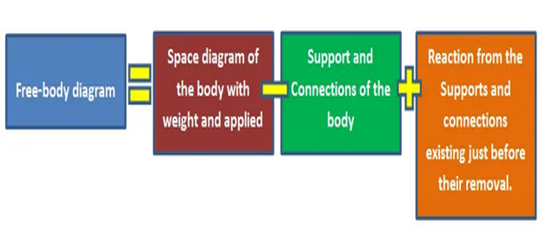
A practical definition of the FBD may be written in the form of an equation as follows:

Slide 29
What is the purpose of a free body diagram?
Free body diagrams are tools that are used to visualize the force and moments applied to a body and to calculate the resulting reactions in many types of mechanics problems.

Slide 30
Guides for drawing free body diagram
The body to be isolated for consideration may be the entire system or any portion of the system. So, it is important to make a clear decision as to which portion of the system is to be freed.
The free body drawn should have no external supports or connections.
Any adopted coordinate system whose axes are not in the horizontal and vertical directions should be shown.
Appropriate dimensions which are needed in defining the configuration of the force system, should be indicated.

Slide 31
Each applied load should be indicated with an arrow and labeled either with its known magnitude or with a letter when it is not known.
The weight force of the free body should be indicated with a vertical downward arrow and labeled if the weight is not negligible.
The action exerted by the body on its supports and connections should not be indicated with arrows and labeled.
The sense of an unknown force, when not reasonably obvious, may be assumed and corrected later if the value obtained is negative.
The forces in the cords or members which are uncut in the free body diagram should not be shown.

Slide 32
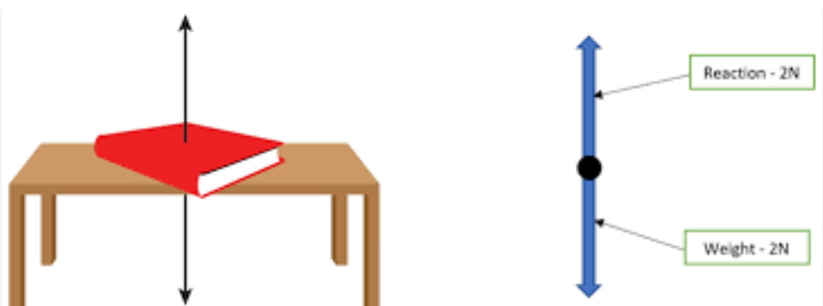
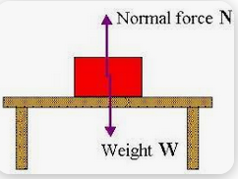

Slide 33
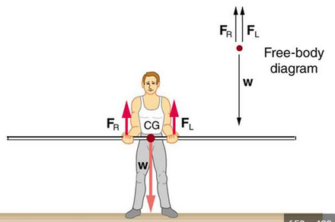
Examples:

Slide 34
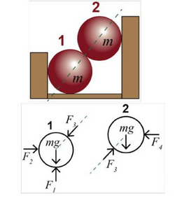

Slide 35
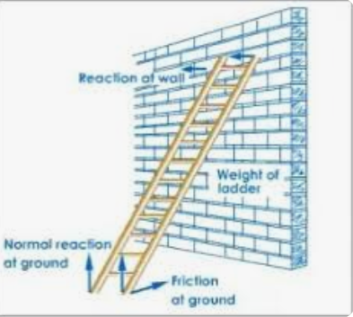

Slide 36
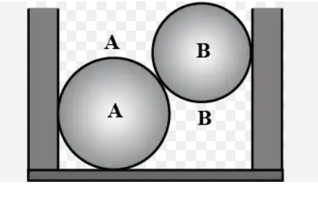
Examples:

Slide 37
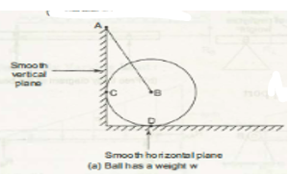
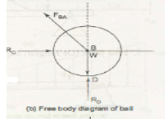

Slide 38
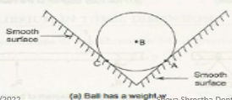
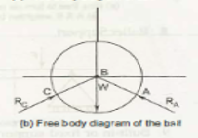

Slide 39
1.5 Equation of equilibrium in two dimension

Slide 40
Equilibrium
When a rigid body or particles is acted upon by many number of forces, the rigid body or particles is said to be in equilibrium if there is no unbalanced force acting on it, so that the resultant of all forces must be zero.
If the body is at rest or moves with constant velocity it is said to be in equilibrium.
In eqiuilibrium, body donot possess acceleration.

Slide 41
Type of Equilibrium
1.Static equilibrium
2.Dynamic Equilibrium
Bodies are at rest
Bodies move with constant velocity

Slide 42
Importance of equilibrium
To determine the internal forces and stresses which are induced due to the effect of applied load by considering the rigid body is in equilibrium condition.
To check the stability of the structure.
To determine the unknown parameter(reaction forces, moment)applied on the structure or body when given system is in equilibrium.

Slide 43
Principle of equilibrium
The following are three important principles of equilibrium of coplanar, concurrent forces.
Two force principle : If body in equilibrium is acted upon by two forces, then they must be equal, opposite and collinear.
Three force principle: If a body in equilibrium is acted upon by three forces, then the resultant of any two forces must be equal and opposite and collinear with the third force.
Four force principle: : If a body in equilibrium is acted upon by four forces, then the resultant of any two forces must be equal, opposite and collinear with the resultant of other two force.

Slide 44
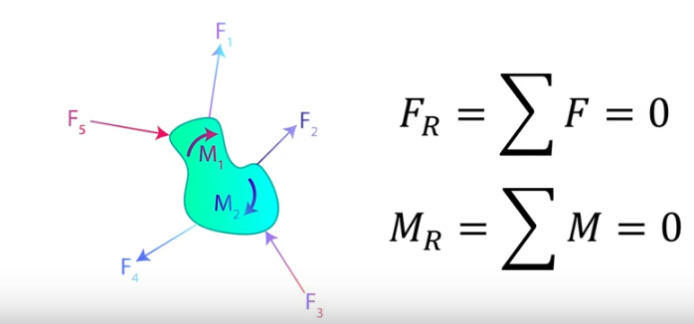
Equation of equilibrium in two dimension

Slide 45
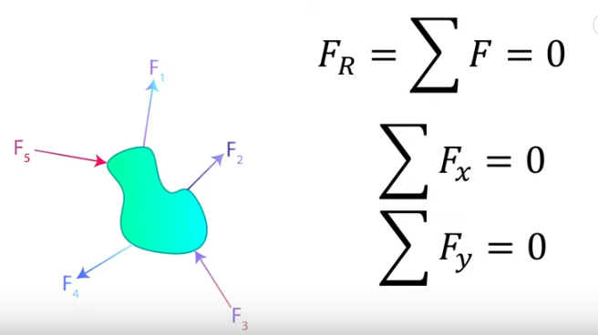

Slide 46
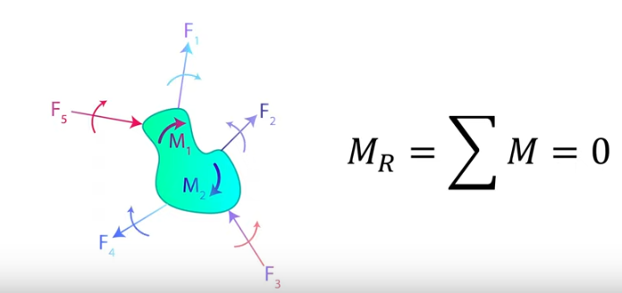

Slide 47
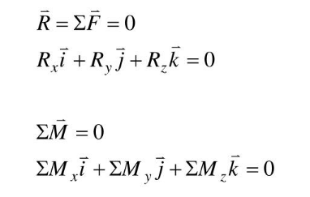
Equilibrium in two dimensions(3D)
When a rigid body is in equilibrium ,both the resultant force and the resultant couple must be zero.

Slide 48
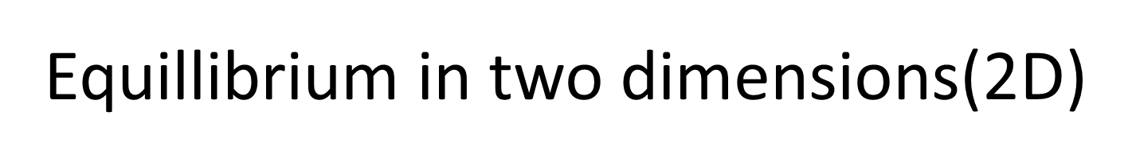
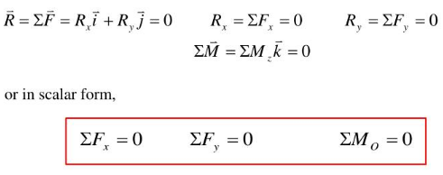


Slide 49
Scalar and vector quantities
Scalar quantities have only magnitude but no direction. e.g. mass, length, density, work, pressure, heat, current etc.
Vector quantities have both magnitude as well as direction. E.g. velocity, acceleration, moment, impulse, force etc.

Slide 50
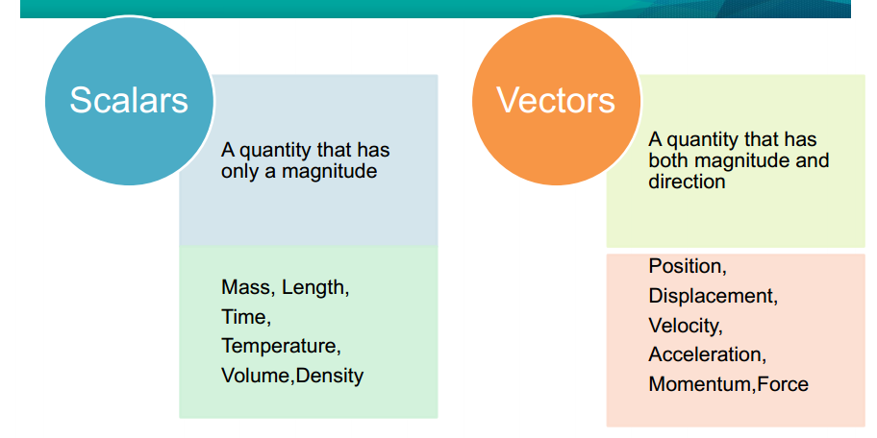

Slide 51
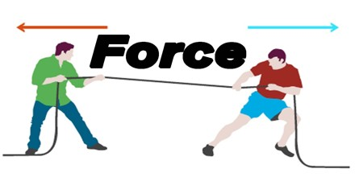

Slide 52
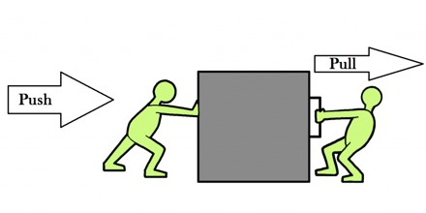
Force
Thus force may be defined as a push or pull which either changes or tend to change the state of rest or of uniform motion of a body.
Force is a vector quantity.

Slide 53
Characteristics of force
The followings are the characteristics of a force:
1.Magnitude:The quantity of a force is called its magnitude such as 50 N, 80 N, 25 kg etc.
2.Direction: The direction of a force is the direction of the line along which it acts.
3.Nature of the force or sense: Nature of the force means whether the force is a push or a pull at the point of application.

Slide 54
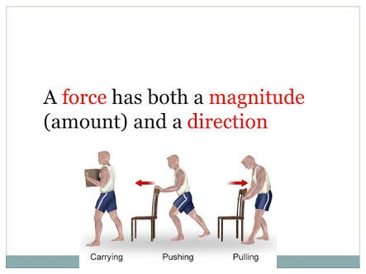

Slide 55
Effects of a force
A force acting on body may have the following effects on the body:
1. It may change the state of rest or of uniform motion of a body.
2. It may change the direction of motion of a moving body.
3. It may change the shape and size of the body.
4. It may produce internal stresses in the body.

Slide 56
Types of forces:1) External and 2) Internal Forces
External Forces:
responsible for the external behavior of the rigid bodies.
cause the rigid bodies to move or ensure that they remain at rest.
Internal Forces:
hold together the particles or parts forming the rigid body.

Slide 57
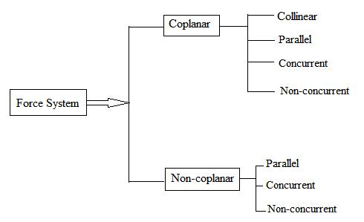
System of forces

Slide 58
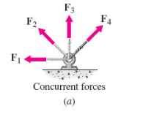
What is a force system?
A number of forces (in 2D or 3D system) that is treated as a group:
A concurrent force system – All of the action lines intersect at a common point.

Slide 59
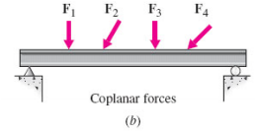
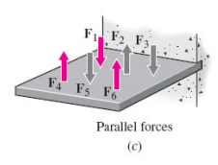
What is a force system?
A coplanar force system – All of the forces lie in the same plane.
A parallel force system – All of the action lines are parallel

Slide 60
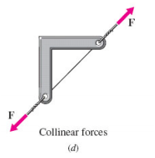
What is a force system?
A collinear force system – All of the forces share a common line of action.

Slide 61
Collinear forces
Collinear forces are forces which have a common line of action, i.e. the line of action of the forces lie along a single straight line.
Examples: two people standing at the opposite ends of a rope and pulling on it.
a suspended load by a cable.

Slide 62
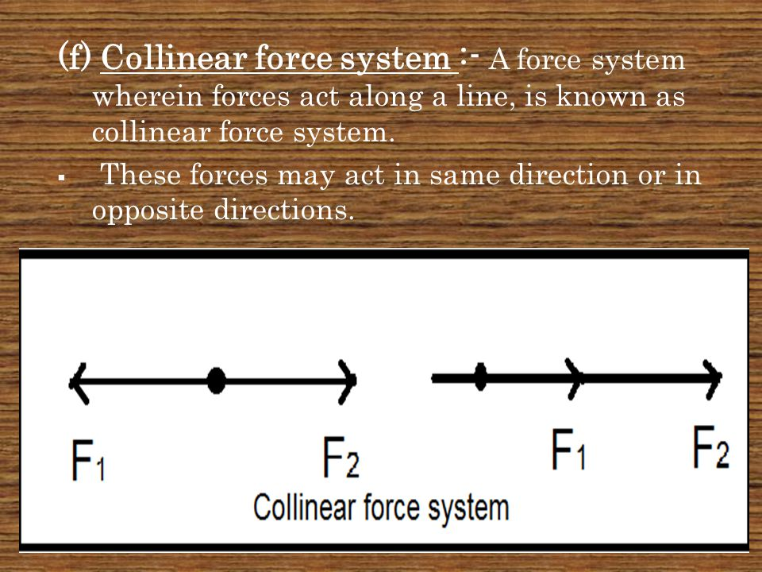

Slide 63
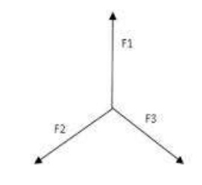

Coplanar concurrent forces.
The forces, which meet at one point and their lines of action also lie on the same plane, are known as coplanar concurrent forces.

Slide 64
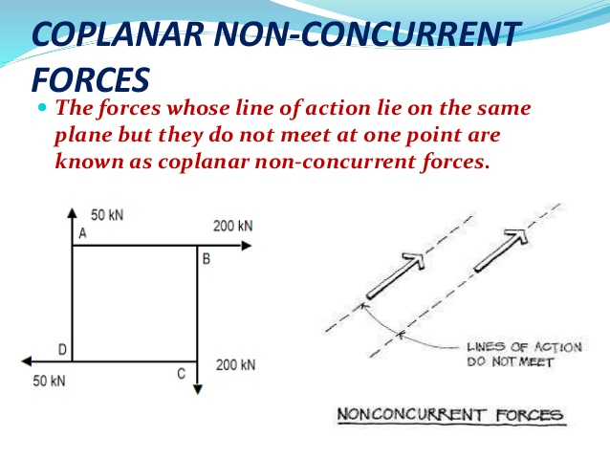
Coplanar non-concurrent forces.
The forces, which do not meet at one point, but their lines of action lie on the same plane, are known as coplanar non-concurrent forces.

Slide 65
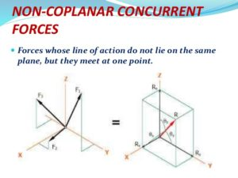
Non-coplanar concurrent forces
The forces, which meet at one point, but their lines of action do not lie on the same plane, are known as non-coplanar concurrent forces.

Slide 66
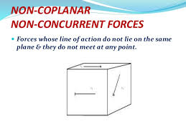
Non-coplanar non-concurrent forces
The forces, which do not meet at one point and their lines of action do not lie on the same plane, are called non-coplanar non-concurrent forces

Slide 67
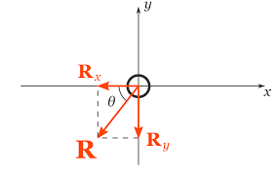
RESULTANT FORCE
If a number of forces, P, Q, R ... etc. are acting simultaneously on a particle, then it is possible to find out a single force which could replace them i.e., which would produce the same effect as produced by all the given forces.
This single force is called resultant force and the given forces R ... etc. are called component forces
.

Slide 68
RESOLUTION AND COMPOSITION OF FORCES
The process of finding out the resultant force, of a number of given forces, is called composition of forces or compounding of forces.

Slide 69
Methods for resultant force
Analytical method
Method of resolution
Parallelogram law of force
Method of resolution

Slide 70
Parallelogram law of forces
Parallelogram law of forces states that if two forces acting simultaneously on a particle are represented in magnitude and direction by the two adjacent sides of a parallelogram, then their resultant is represented in magnitude and direction by the diagonal of the parallelogram passing through their point of intersection.

Slide 71
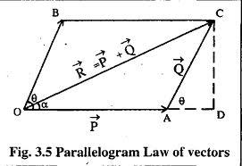
F2
F1

Slide 72
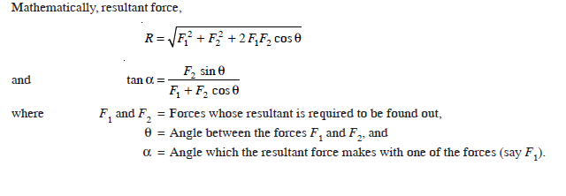

Slide 73
Triangle law of forces
Triangle law of forces states that if two forces acting simultaneously on a particle are represented in magnitude and direction by the two sides of a triangle taken in order, then their resultant is represented in magnitude and direction by the third side of the triangle taken in opposite order.

Slide 74
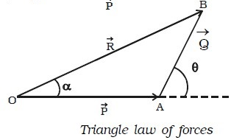

Slide 75
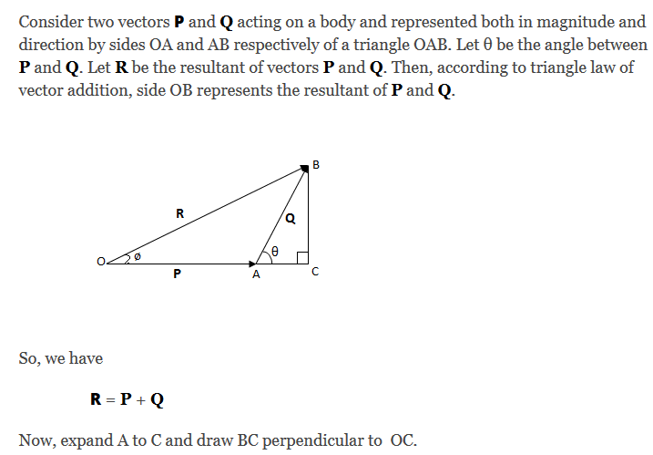

Slide 76
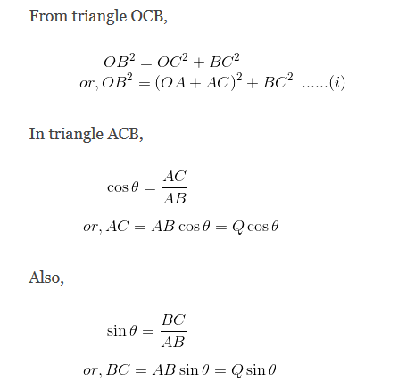

Slide 77
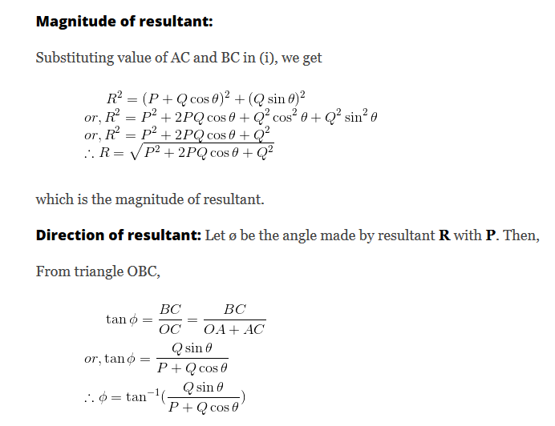

Slide 78
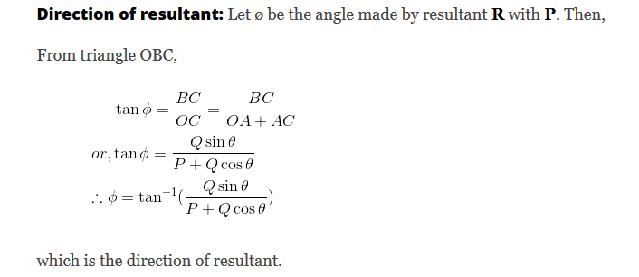

Slide 79
POLYGON LAW OF FORCES
It is an extension of Triangle Law of Forces for more than two forces, which states, “
“ If a number of forces acting simultaneously on a particle be represented in magnitude and direction by the sides of a polygon taken in order then the resultant of all these forces may be represented in magnitude and direction by the closing side of the polygon taken in opposite order”.

Slide 80
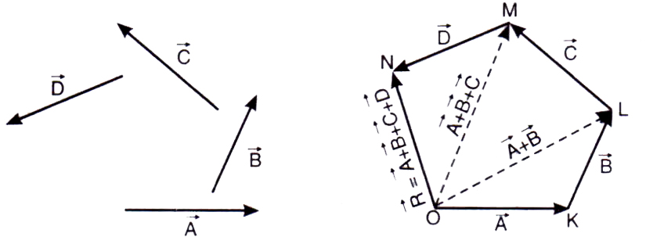

Slide 81
Principal of transmissibility of forces
It states that the point of application of a force may be changed to any other point along the line of action of the force without any change in the external effects produced by the force.

Slide 82
Principle of transmissibility
F
=
F’
F and F’ have the same effect if their magnitude , direction and line of action are the same. Based on experimental evidence.

Slide 83
Principle of transmissibility
Conditions of motion are unaffected. F and F’ are equivalent
F
=
F’
W
W
R1
R2
R1
R2

Slide 84
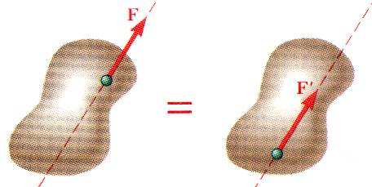
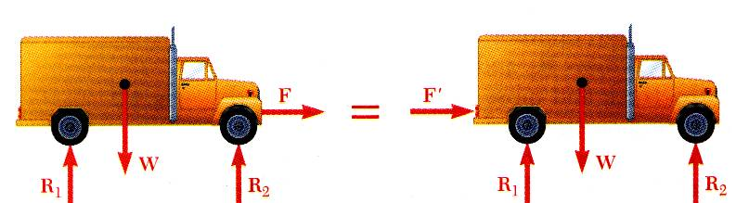
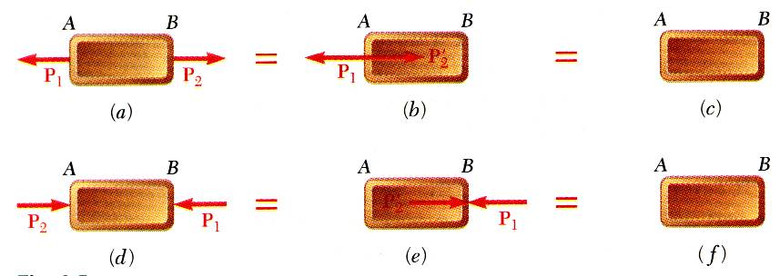
Principle of Transmissibility: Equivalent Forces
Principle of Transmissibility - Conditions of equilibrium or motion are not affected by transmitting a force along its line of action. NOTE: F and F’ are equivalent forces.
Moving the point of application of the force F to the rear bumper does not affect the motion or the other forces acting on the truck.
Principle of transmissibility may not always apply in determining internal forces and deformations.

Slide 85
Vector expressed in terms of rectangular components
Vector product of any 2 units vectors: i, j, k
i x j= k
j x i= -k
j x k= i
k x j= -i
k x i= j
i x k= -j
i x i= 0, j x j= 0, k x k= 0
y
j
i
k
x
z
(+):CCW
j
k
i
(-):CW

Slide 86
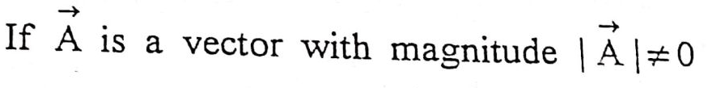
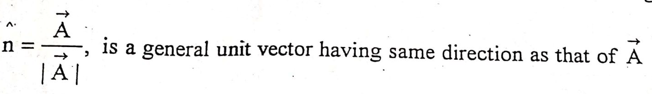
Unit vector in Cartesian Coordinate
It is vector of unit magnitude.

Slide 87
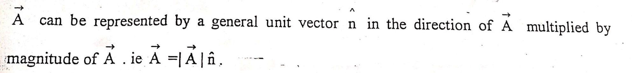

Slide 88
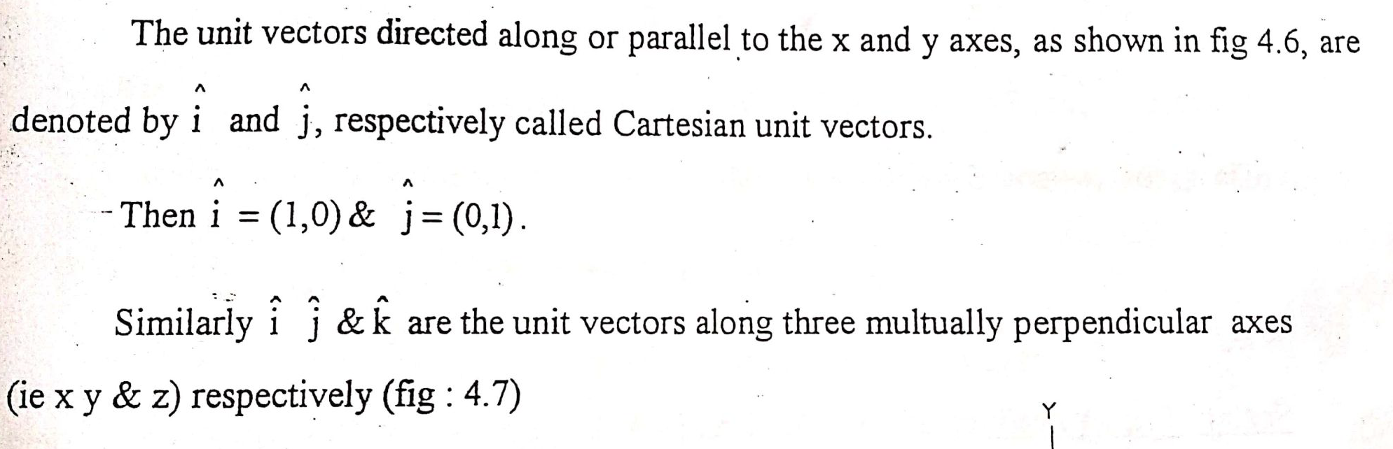


Slide 89


Slide 90


Slide 91


Slide 92


